Slide 1
Discrete Mathematics Graphs
by Akkradach W.
Dept. of Computer Engineering
KMITL

Slide 2
Agenda
Chapter 9
Graphs and Graph Models
Graphs Terminology and Special Types
Graph Representations and Isomorphism
Connectivity
Euler and Hamilton Paths
Shortest-Path Problems

Slide 3
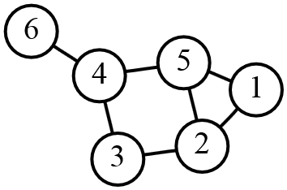
Graphs (1)
G = (V, E)
V : a nonempty set of vertices (nodes)
E : a set of edges
An edge is said to connect its endpoint(s)
If V is infinite set, G is called infinite graph

Slide 4
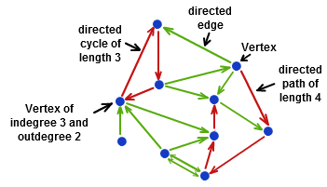
Graphs (2)
Directed graph (digraph)
E : a set of directed edges (arcs) which associated with the ordered pair (u, v) is said to start at u and end at v

Slide 5
Graphs (3)
Type | Edges | Permit Multiple Edges? | Permit Loops?
Simple graph | Undirected | No | No
Multigraph | Undirected | Yes | No
Pseudograph | Undirected | Yes | Yes
Simple directed graph | Directed | No | No
Directed multigraph | Directed | Yes | Yes
Mixed graph | Both | Yes | Yes

Slide 6
Graph Models
Niche Overlap Graphs in Ecology
Acquaintanceship Graphs
Influence Graphs
The Hollywood Graph
Round-Robin Tournaments
Collaboration Graphs
Call Graphs
Precedence Graphs and Concurrent Processing

Slide 7
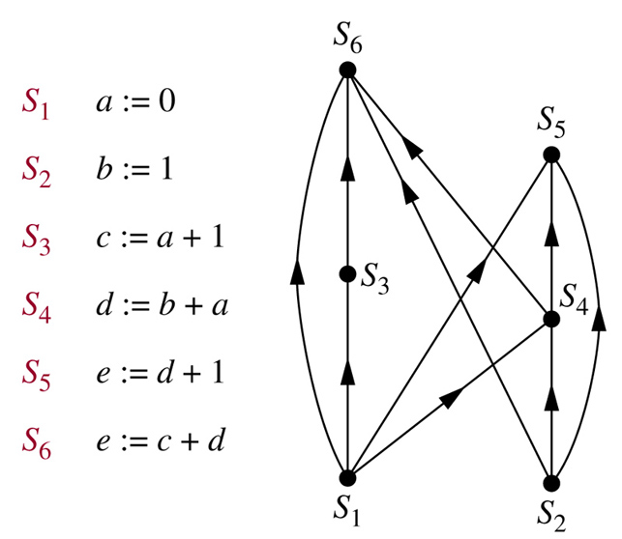
Precedence Graphs and Concurrent Processing

Slide 8
Graph Terminology – Undirected (1)
Adjacent (neighbors) : {u, v}
u and v are endpoints of an edge of G
If e is associated with {u, v} then
e is called incident with u and v
e is also said to connect u and v
Degree of a vertex, deg(v), is the number of edges incident with it (Loop?)
If deg(v)=0, then v is called isolated
If deg(v)=1, then v is called pendant

Slide 9
Graph Terminology – Undirected (2)
Handshaking Theorem
Let G = (V, E) with e edges, then
2e = Σ_{v∈V} deg(v)
An undirected graph has an even number of vertices of odd degree

Slide 10
Graph Terminology – Directed (1)
Adjacent : (u, v)
u is called the initial vertex of (u, v)
v is called the terminal or end vertex of (u, v)
u is said to be adjacent to v
v is said to be adjacent from u
In-degree of a vertex, deg⁻(v), is the number of edges with v as their end vertex
Out-degree of a vertex, deg⁺(v), is the number of edges with v as their initial vertex
Loops?

Slide 11
Graph Terminology – Directed (2)
Let G = (V, E), then
Σ_{v∈V} deg⁻(v) = Σ_{v∈V} deg⁺(v) = |E|

Slide 12
Special Types
Special Simple Graphs
Complete Graphs (K_{n}; n∈Z⁺)
Cycles (C_{n}; n≥3)
Wheels have an additional vertex from C_{n} (W_{n})
n-dimensional hypercube (Q_{n})
Bipartite Graphs
A simple graph G is called bipartite if its vertex set V can be partitioned into two disjoint sets V₁ and V₂ such that every edge connects a vertex in V₁ and in V₂ (K_{m,n})
No edge in G connects either two vertices in V₁ or in V₂

Slide 13
Some Applications
Job Assignments
Local Area Networks (LAN)
Interconnection Networks for Parallel Computation

Slide 14
New from Old
A subgraph of G = (V, E) is a graph H = (W, F) where W ⊆ V and F ⊆ E
A proper subgraph : if H ≠ G
The union of two simple graphs G₁ = (V₁, E₁) and G₂ = (V₂, E₂), G₁∪G₂, is the simple graph with vertex set V₁∪V₂ and edge set E₁∪E₂

Slide 15
Graph Representations (1)
An Adjacency List for a Simple Graph
Vertex | Adjacent Vertices
a | b, c, e
b | a
c | a, d, e
d | c, e
e | a, c, d

Slide 16
Graph Representations (2)
An Adjacency List for a Directed Graph
Initial Vertex | Terminal Vertices
a | b, c, d, e
b | b, d
c | a, c, e
d
e | b, c, d

Slide 17
Graph Representations (3)
Adjacency Matrices (A_{G})
Suppose that G = (V, E) is a simple graph where |V| = n and the vertices of G are listed as v₁, v₂, …, v_{n}
Then A_{G} is the n×n zero-one matrix = [a_{ij}] that
a_{ij} = 1 if {v_{i}, v_{j}} is an edge of G
a_{ij} = 0 otherwise
It is symmetric, because of a simple graph
Because a simple graph has no loops, a_{ii} is 0

Slide 18
Graph Representations (4)
List VS Matrices
When it is sparse (has few edges),
Adjacency List
Sparse Matrix (?)
When it is dense (has many edges),
Adjacency Matrix
Incidence Matrices (M_{G})
Vertices × Edges matrix (n×m zero-one)
m_{ij} = 1 when edge e_{j} is incident with v_{i}

Slide 19
Graph Isomorphism
The simple graphs G₁ = (V₁, E₁) and G₂ = (V₂, E₂) are isomorphic if
There is an one-to-one and onto function ƒ from V₁ to V₂ with the property that
a and b are adjacent in G₁ if and only if ƒ(a) and ƒ(b) are adjacent in G₂, for all a and b in V₁
Such a function ƒ is called an isomorphism
It is very hard to determine whether two LARGE graphs are isomorphic

Slide 20
Graph Isomorphism - Graph Invariant
Numbers of Edges
Numbers of Vertices
Degree of the Vertices

Slide 21
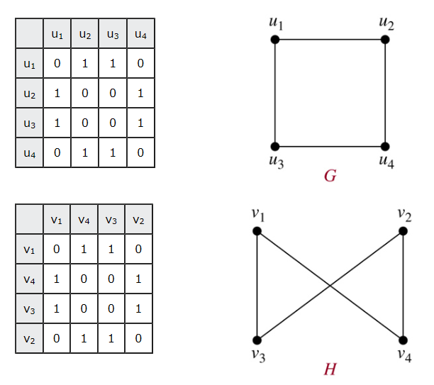
Graph Isomorphism - Adjacency Matrix (1)

Slide 22
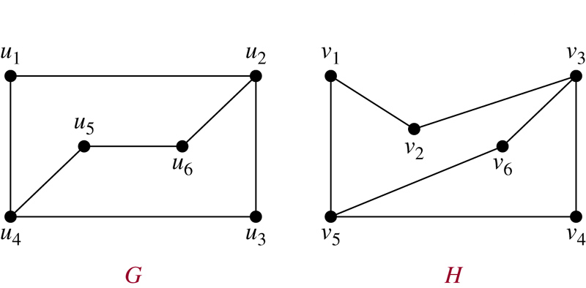
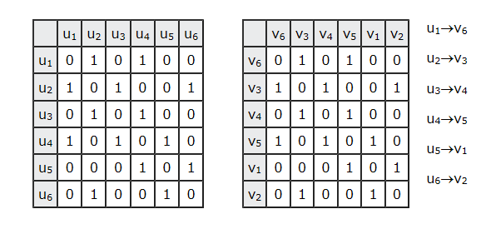
Graph Isomorphism - Adjacency Matrix (2)

Slide 23
Connectivity (1)
A path of length n from u to v in G is a sequence of n edges e₁, …, e_{n} such that e₁ is associated with {x₀, x₁}, e₂ is associated with {x₁, x₂}, and so on, with e_{n} associated with {x_{n-1}, x_{n}}, where x₀= u and x_{n} = v
When the graph is simple, we denote path by x₀, x₁, …, x_{n}
Circuit : u = v and n > 0

Slide 24
Connectivity (2)
Pass through the vertices : x₁, x₂, …, x_{n-1}
Traverse the edges : e₁, e₂, …, e_{n}
Simple Circuit : NOT contain the same edge more than once

Slide 25
Connectedness – Undirected Graph
An undirected graph is called connected if there is a path between every pair of distinct vertices of the graph
There is a simple path between every pair of distinct vertices of a connected undirected graph

Slide 26
Connectedness – Directed Graph
A directed graph is strongly connected if there is a path from a to b and from b to a whenever a and b are vertices in the graph
A directed graph is weakly connected if there is a path between every two vertices in underlying undirected graph

Slide 27
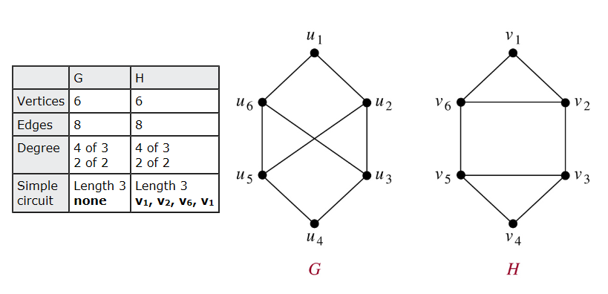
Paths and Isomorphism (1)

Slide 28
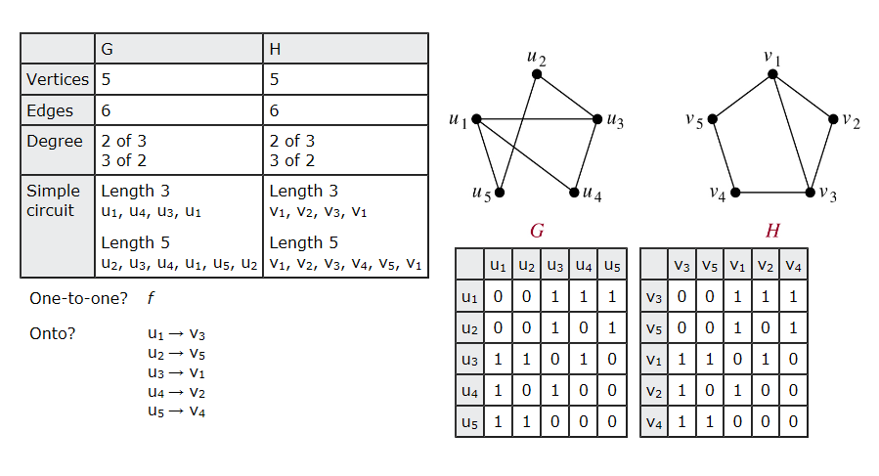
Paths and Isomorphism (2)

Slide 29
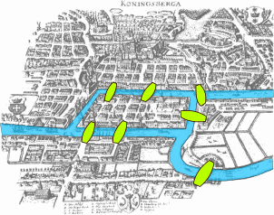
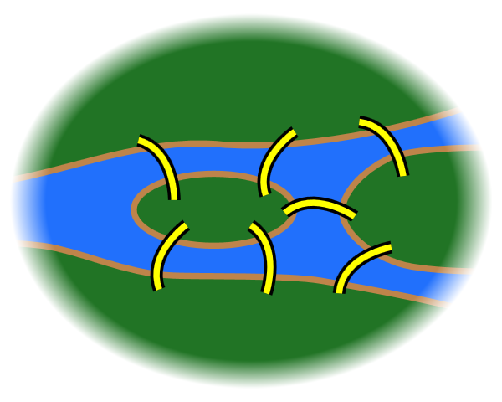
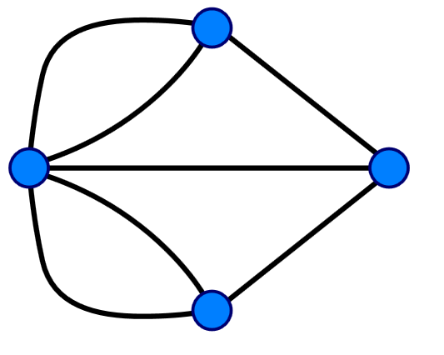
Bridges of Königsberg

Slide 30
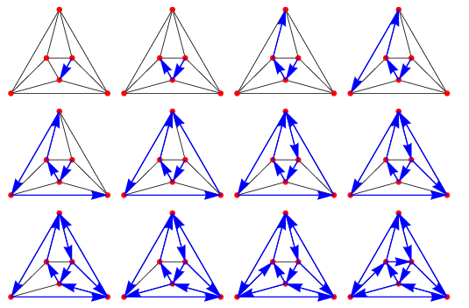
Euler Paths – Edge Once

Slide 31
Euler Paths and Circuits (1)
An Euler path in G is a simple path containing every edge of G
An Euler circuit in a graph G is a simple circuit containing every edge of G

Slide 32
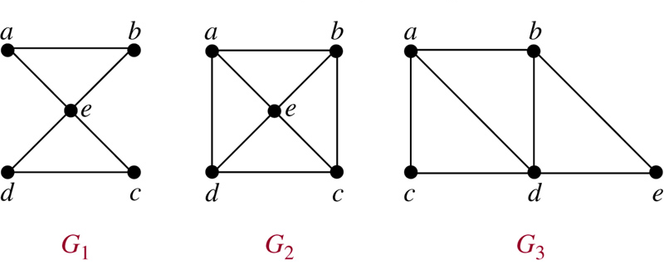
Euler Paths and Circuits (2)

Slide 33
Euler Paths and Circuits (3)
A connected multigraph with at least two vertices has an Euler circuit if and only if each of its vertices has EVEN degree
A connected multigraph has an Euler path but NOT an Euler circuit if and only if it has exactly two vertices of ODD degree

Slide 34
Euler Paths and Circuits (4)
From Handshaking Theorem
Every graph has an even number of odd vertices!
No. of ODD vertices | Euler PATH? | Euler CIRCUIT?
0 | Yes | YES
2 | YES | no
4, 6, 8, … | no | no
1, 3, 5, … | No such graphs exist!

Slide 35
Euler Circuit – Fleury's Algorithm
Pick a vertex to start
From that vertex pick an edge to traverse (“Don't burn your bridges”)
Mark that edge, as a reminder that you can't traverse it again
Travel that edge, coming to the next vertex
Repeat 2-4 until all edges have been traversed, and you are back at the starting vertex

Slide 36
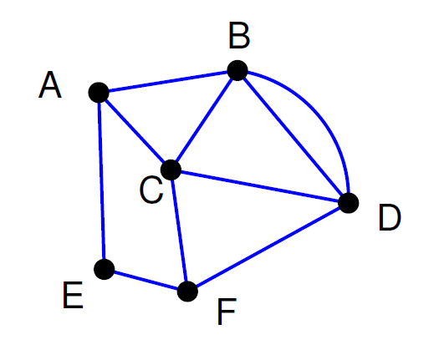

Slide 37
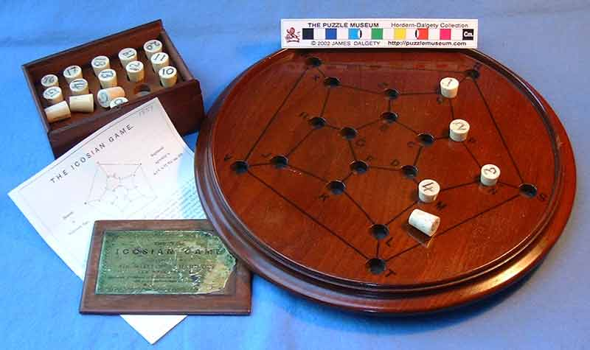
Icosian Game

Slide 38
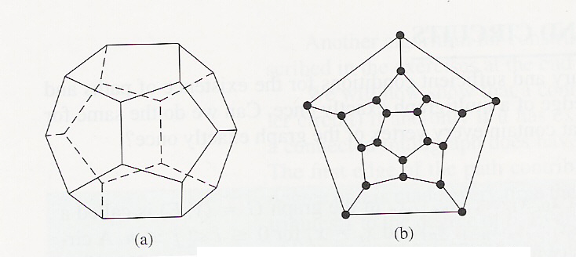
A Voyage Round the World

Slide 39
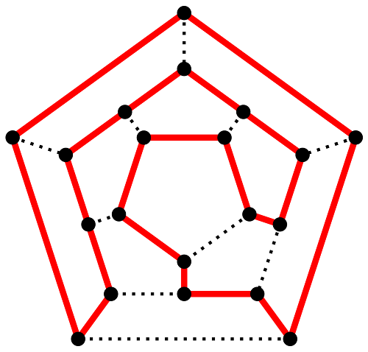
Hamilton Paths – Vertex Once

Slide 40
Hamilton Paths and Circuits (1)
A simple path in a graph G that passes through every vertex exactly once is called a Hamilton path
A simple circuit in a graph G that passes through every vertex exactly once is called a Hamilton circuit

Slide 41
Hamilton Paths and Circuits (2)
Dirac’s Theorem
If G is a simple graph with n vertices with n≥3 such that the degree of every vertex in G is at least n/2, then G has a Hamilton circuit
Ore’s Theorem
If G is a simple graph with n vertices with n≥3 such that deg(u)+deg(v)≥n for every pair of nonadjacent vertices u and v in G, then G has a Hamilton circuit

Slide 42
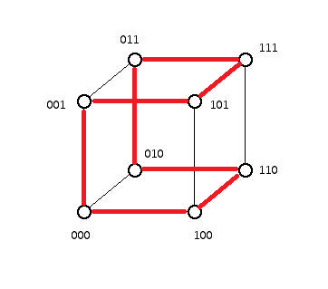
Hamilton Paths and Circuits (3)
Traveling Salesman Problem
Gray Code

Slide 43
Shortest-Path Problems
Dijkstra’s algorithm finds the length of a shortest path between two vertices in a connected simple undirected weighted graph

Slide 44
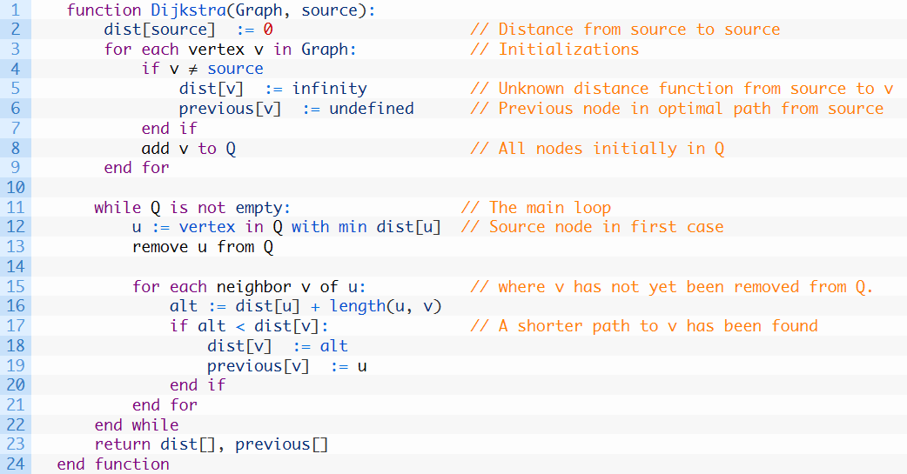
Shortest-Path Problems – Dijkstra’s Algorithm

Slide 45
